Slide 1

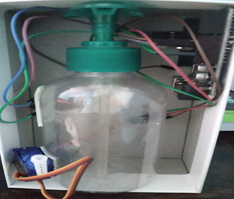
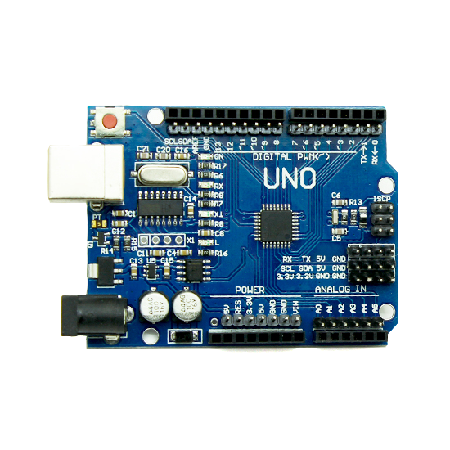

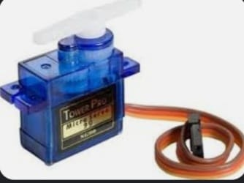

AAA COLLEGE OF ENGINEERING & TECHNOLOGY
(An ISO 9001 : 2015 Certified Institution)
(Approved by AICTE, New Delhi & Affiliated to Anna University, Chennai)
Amathur, Sivakasi - 626 005.
DEPARTMENT OF ELECTRONICS AND COMMUNICATION ENGINEERING
Project Title :
AUTOMATIC HAND SANITIZER USING ARDUINO UNO
Objective
Proposed Work
To Prevent Pandemic of Covid 19 virus.
To Safeguard us from Covid 19.
The proposed Hand Sanitizer make use of destroying covid 19 virus .
It may also make use of destroying any other virus that are Harmful to human health.
Hand Sanitizer machine is a simple mechanism that used for sanitation purpose.
Components used
Experimental setup
Future Enhancement
As a future enhancement , motorised method of similar mechanism for the usage of any other hand wash or other similar Application.
Notes:
1

Slide 2
AUTOMATIC HAND SANTIZIER CODING
#include<iostream.h>
int pump=2;
int trig_Pin=3;
int echo_Pin=4;
long Time;
int distance;
void setup()
{
Serial.begin (9600);
pinMode (trig_Pin,OUTPUT); pinMode(echo_Pin,INPUT);
pinMode(pump, OUTPUT);
}
void loop()
{
digitalWrite(trig_Pin,LOW);
delayMicroseconds(2);
digitalWrite(trig_Pin,HIGH);
delayMicroseconds(10);
digitalWrite(trig_Pin,LOW);
Time=pulse In (echo_Pin, HIGH);
distance=Time*0.034/2;
Serial.print("Distance:" );
Serial.print(distance);
if(distance<15)
{
digitalWrite(pump, HIGH);
}
else
{
digitalWrite(pump, LOW);
}
}

